Slide 1

PyTorch ONNX + Raspberry Pi + NCS Workflow
※ 2022. 12. 27 기준
Host PC (GPU)
Raspberry Pi 4 + NCS 2
OpenVINO 2021.4.2
OpenVINO 2021.4.2
NCS 2
모델
전달
딥러닝 모델
NCS 2 탑재
Model Optimizer 이용
OpenVINO Intermediate Representation (IR) 변환
OpenVINO
Inference Engine
Setup
딥러닝 모델
NCS 2 이용
Inference 수행
딥러닝 모델 읽기
PyTorch 딥러닝 모델 ONNX 변환
입출력 Layer 정의
입출력 형태 정의
출력
데이터 blob 생성
입력
이미지
데이터 blob 변환
입력 데이터 전달
딥러닝 네트워크
Evaluation Mode 전환
Inference 출력 전달
입력 이미지
데이터 로딩
딥러닝 네트워크 학습
OpenCV-Contrib-Python

Slide 2
PyTorch ONNX + Raspberry Pi + NCS Workflow
※ 2022. 12. 27 기준
[ 관련 Reference ]
Conversion of PyTorch Classification Models and Launch with OpenCV Python : https://docs.opencv.org/4.x/dc/d70/pytorch_cls_tutorial_dnn_conversion.html
Part 1: Deploying a PyTorch MobileNetV2 Classifier on the Intel Neural Compute Stick 2 : https://pemami4911.github.io/blog/2021/07/09/part-1-neural-compute-stick-2.html
OpenVINO 2021.4.2 설치 패키지 Repository : https://storage.openvinotoolkit.org/repositories/openvino/packages/2021.4.2/
OpenVINO 2021.4.2 Toolkit 설치 가이드 : https://docs.openvino.ai/2021.4/openvino_docs_install_guides_installing_openvino_linux.html
OpenVINO Model Optimizer ONNX IR 변환 : https://docs.openvino.ai/latest/openvino_docs_MO_DG_prepare_model_convert_model_Convert_Model_From_ONNX.html
OpenVINO PyTorch – ONNX – OpenVINO IR 변환 : https://docs.openvino.ai/2021.4/notebooks/102-pytorch-onnx-to-openvino-with-output.html
OpenVINO, OpenCV, and Movidius NCS on the Raspberry Pi : https://pyimagesearch.com/2019/04/08/openvino-opencv-and-movidius-ncs-on-the-raspberry-pi/
EEMBC – 임베디드 딥러닝 벤치마크 : https://www.eembc.org/mlmark/scores.php

Slide 3
Host PC OpenVINO Setup
※ 2022. 12. 27 기준
Host PC - OpenVINO 2021.4.2
wget https://storage.openvinotoolkit.org/repositories/openvino/packages/2021.4.2/l_openvino_toolkit_data_dev_ubuntu20_p_2021.4.752.tgz -O openvino_2021.4.2_dev.tgz
Host PC – Model Optimizer Setup

Slide 4
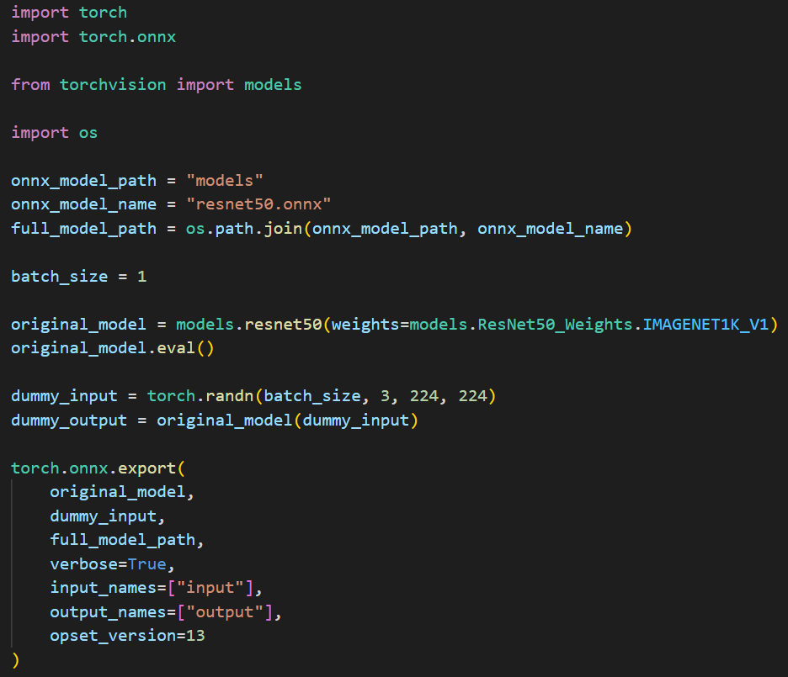
PyTorch ONNX + Raspberry Pi + NCS Workflow
※ 2022. 12. 27 기준
Host PC – Anaconda (pytorch) : PyTorch – ONNX Conversion

Slide 5
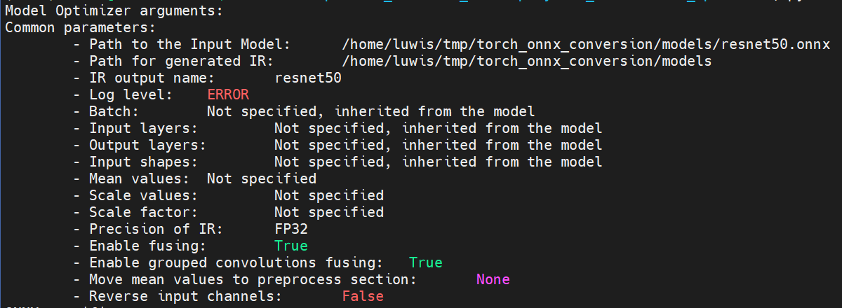
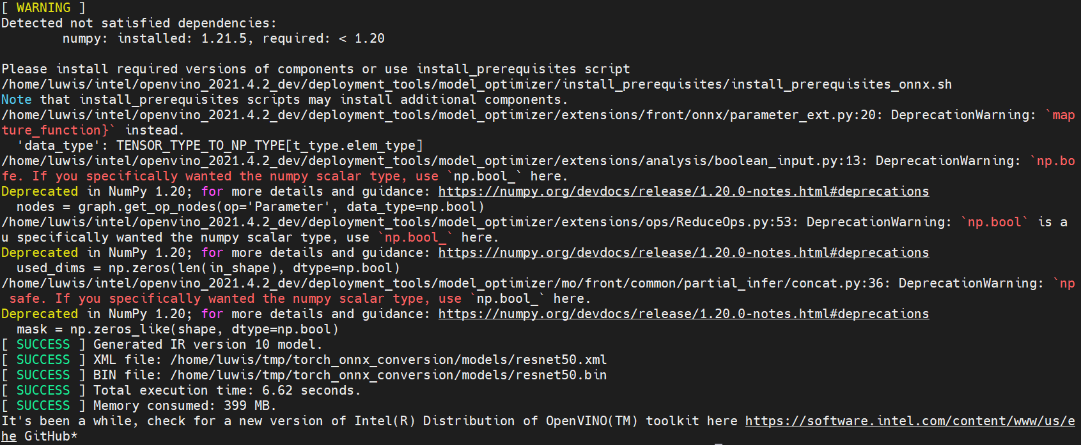
PyTorch ONNX + Raspberry Pi + NCS Workflow
※ 2022. 12. 27 기준
Host PC – Anaconda (base) : Model Optimizer Conversion Success

Slide 6
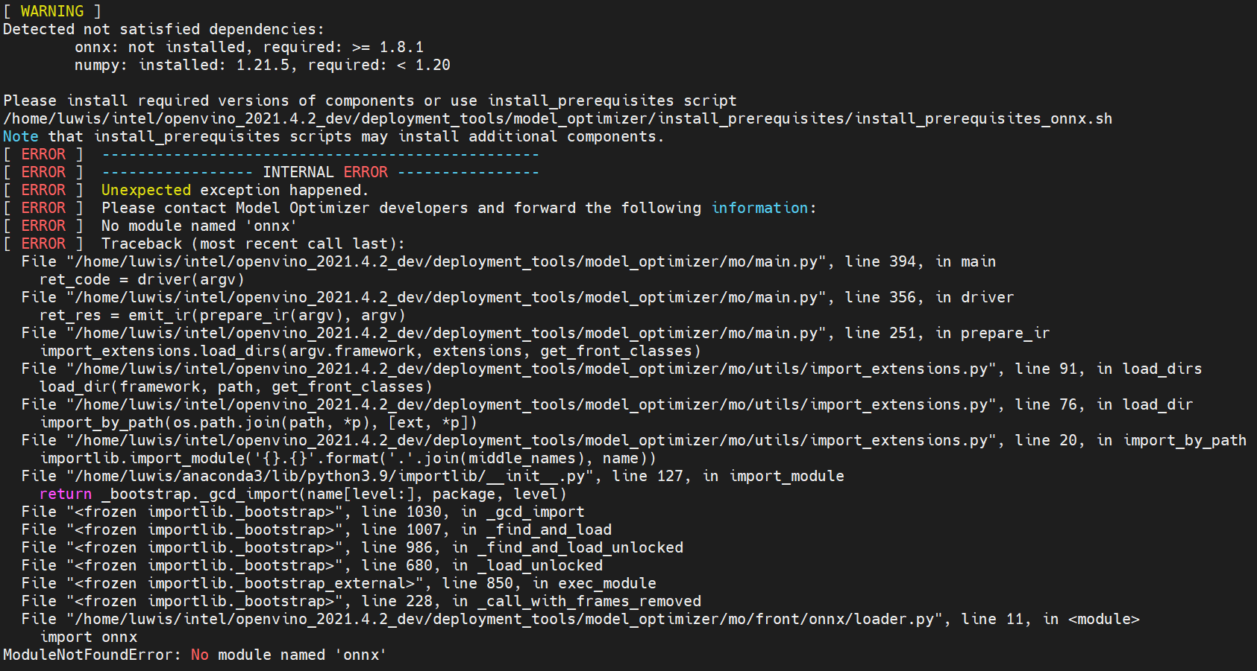
PyTorch ONNX + Raspberry Pi + NCS Workflow
※ 2022. 12. 27 기준
Host PC – Anaconda (base) : Model Optimizer Conversion Fail – Depedency Error
Prerequisites : onnx, networkx, numpy

Slide 7
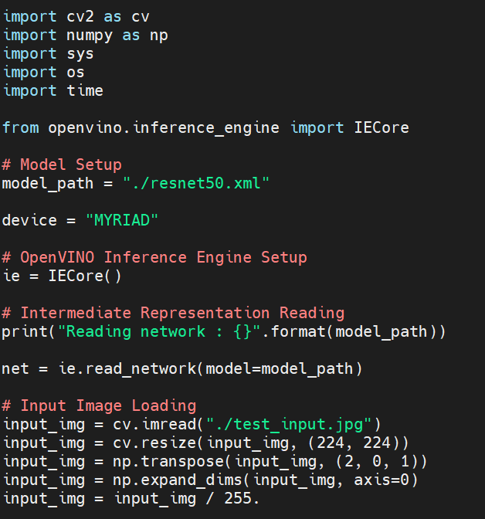
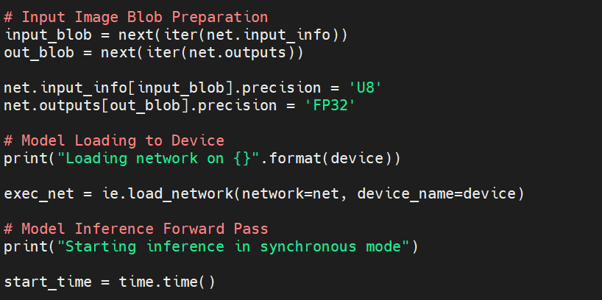
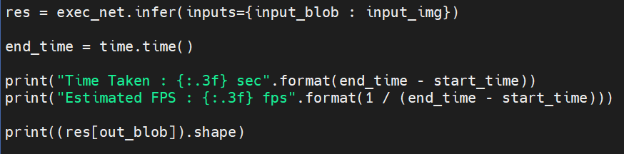
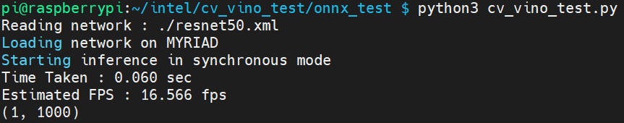
PyTorch ONNX + Raspberry Pi + NCS Workflow
※ 2022. 12. 27 기준
Raspberry Pi 4 + NCS 2 : OpenVINO Inference Run

